Slide 1
Welcome to the ML/AI Club

Slide 2
Who are we?
A group interested in all aspects of AI
Our interests are focused on:
Technical Implementations
Social and Ethical Implementations
New use cases for the technology

Slide 3

What is the club about?
Group to talk AI and Data Science with
Place to learn skills and meet people that will motivate you
Place to brainstorm
Project ideas, problem solving, etc..
Place to meet people to collaborate with

Slide 4
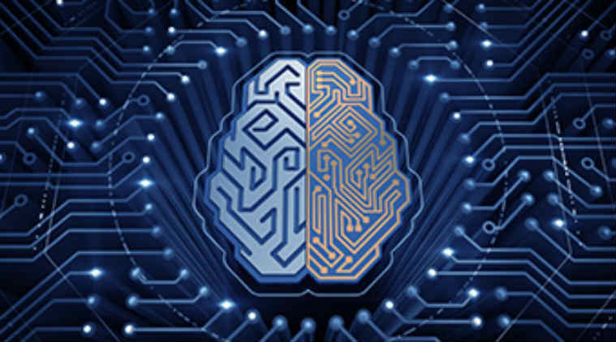
What is ML and AI?
Mathematical models that generate an expected output from a given input - y = mx + b
Large number of algorithms and techniques for various problem types and input data
We will be covering all of the following:
Natural Language Processing
Numerical Data Processing
Image Processing

Slide 5
Why ML and AI?
Incredibly high demand for skills
Super cool and fulfilling
If you have a computer and free time, you can practice anywhere (as opposed to robotics or team based club)
Very well paying
Pays super well

Slide 6
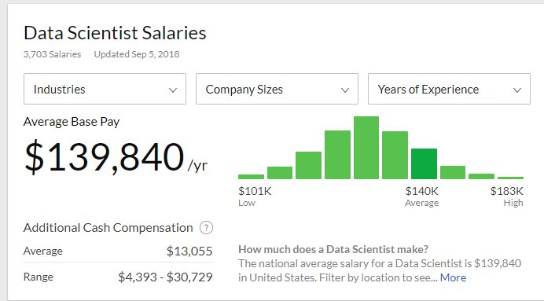
Data Science Salaries

Slide 7
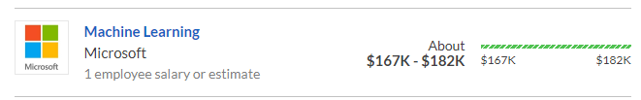


Machine Learning Salaries

Slide 8






Industries utilizing ML/AL
Finance
Healthcare
Defense
Advertising
Transportation
Energy
Actually every single industry

Slide 9
Semester Goals
Learn Python
Provide opportunity to build skillset required for Algorithm implementation
Learn Data Pipelines
Learn Algorithm Implementation
Stay up to date on relevant news events regarding AI and societal implications

Slide 10

Learning Python
6 week program to learn everything you need
6 weeks max
Learn everything you need to be dangerous
Build a confident skillset that will make you hirable by any firm
Build foundation and passion to want to learn more independently

Slide 11
Learning Algorithms
Meeting structure
45 min high level overview
Code breakout afterwards for those interested
Github
https://github.com/AIClubUA
Will be posting all meeting presentations and tons of other resources
Presentation of research papers

Slide 12
Next Week:
Algorithm Implementation:
9/10 – Recurrent Neural Nets to Classify Toxic Comments
Python Basics:
09/13 – Introduction to Python Syntax

Slide 13
Thank you for coming!

